Slide 1


Enhanced eCommerce Product Categorization
Accurately categorizing products is crucial for ecommerce businesses. This presentation explores data-driven techniques to enhance product categorization, leading to better customer experiences and increased sales.
Ta
by T. Anirudh SUNIL

Slide 2

Introduction
Effective product categorization helps customers navigate online stores, improves search and recommendation algorithms, and provides valuable business insights. This project aims to develop a robust product categorization model using machine learning techniques.

Slide 3
The importance of accurate product categorization in eCommerce.
Challenges: ambiguities, unconventional naming conventions, multi-language data.
Cleaned the data (e.g., remove special characters, lowercase text)
df['description'] = df['description'].str.replace('[^a-zA-Z0-9\s]', '').str.lower()

Slide 4
Problem Statement and Objectives
1
Problem Statement
2
Key Objectives
Categorize products into a predefined taxonomy with high accuracy to enhance the customer shopping experience and drive business growth.
1. Analyze product data to understand key features and relationships. 2. Develop a predictive model to accurately classify products. 3. Evaluate model performance and refine for optimal business impact. Data preparation, descriptive analysis, feature engineering, predictive modeling, fine-tuning.

Slide 5
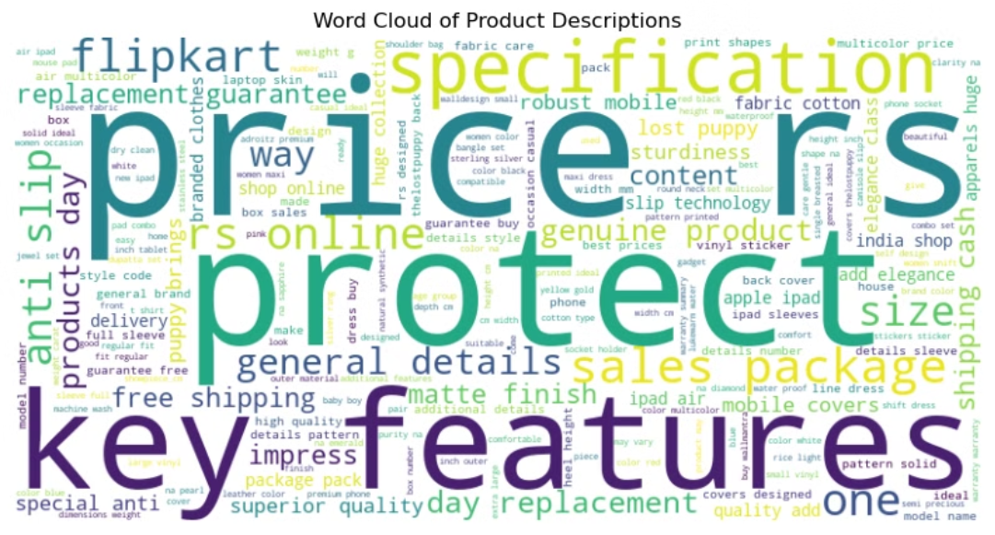
Goal: Developed a text classification model for accurate product categorization.

Slide 6
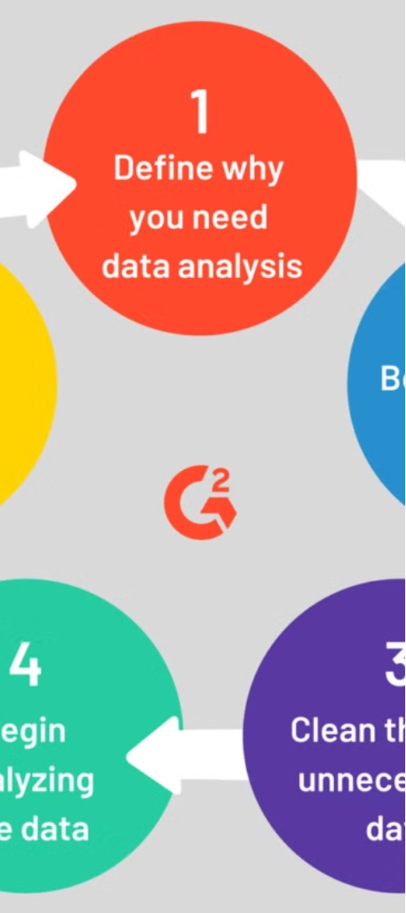
Data Exploration and Preparation
1
Data Collection
Gather product data, including descriptions and combined the data.
2
Data Cleaning
Clean and preprocess the data, handling missing values,deleted missing datas, removing duplicates, and standardizing formats.
3
Feature Engineering
Identify and extract relevant features from the data to be used in the predictive model.
Transformed raw product data into numerical features using TF-IDF.
Importance of feature selection for model performance.

Slide 7
Descriptive Analysis and Visualizations
Product Category Distribution
Product Attribute Insights
Visualization Techniques
Analyze the distribution of products across the predefined categories to identify any imbalances or potential challenges.
Explore key product attributes, such as price, weight, and reviews, to uncover patterns and relationships that may inform the categorization model.
Use a variety of visualizations, such as bar charts, scatter plots, and heatmaps, to gain deeper insights into the data.

Slide 8
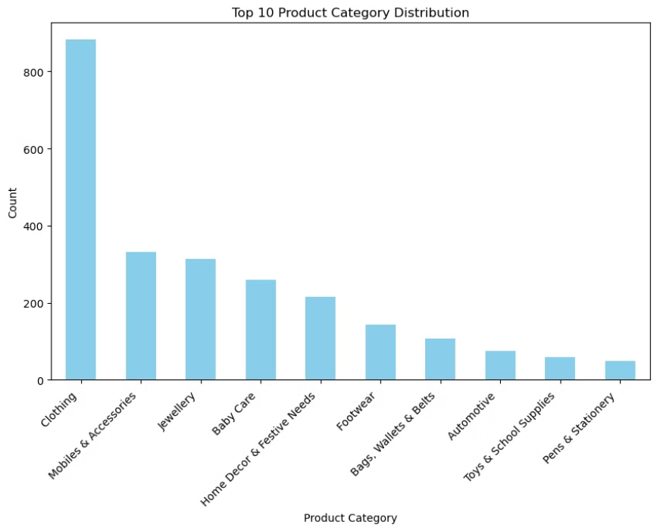
Visual insights: Word cloud of product descriptions, category distribution bar chart.

Slide 9
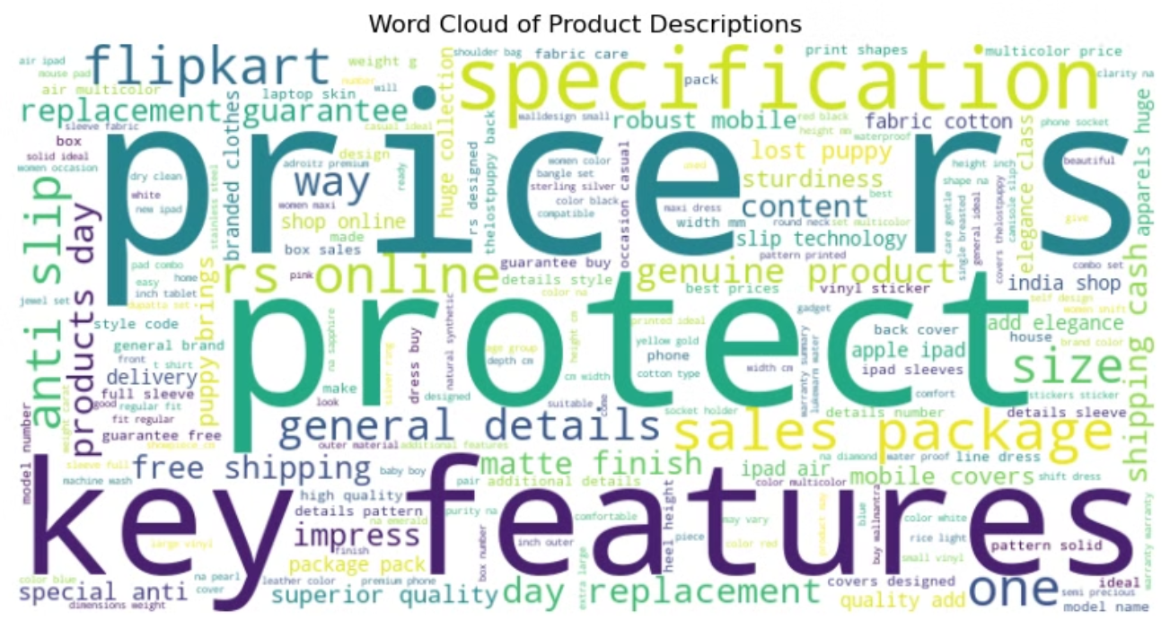

Slide 10
Feature Engineering
Transformed raw product data into numerical features using TF-IDF.
Importance of feature selection for model performance.

Slide 11
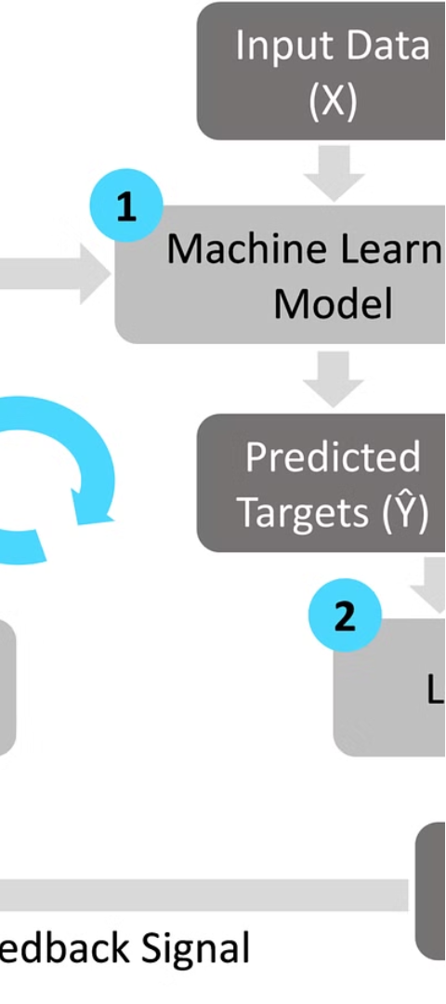



Predictive Modeling
Data Preprocessing
Prepare the data for modeling, including handling missing values, encoding categorical features, and splitting into training and testing sets.
Model Selection
Evaluate and compare the performance of various machine learning algorithms, such as Logistic Regression, Random Forest.
Model Training
Train the selected model on the training data, optimizing hyperparameters, cross validation to achieve the best performance.

Slide 12




Model Evaluation and Fine-Tuning
Accuracy
Precision
Recall
F1-Score
Measure the overall accuracy of the product categorization model.
Evaluate the model's ability to correctly identify products within each category.
Assess the model's ability to correctly classify all products across all categories.
Combine precision and recall to get a balanced measure of the model's overall performance.

Slide 13
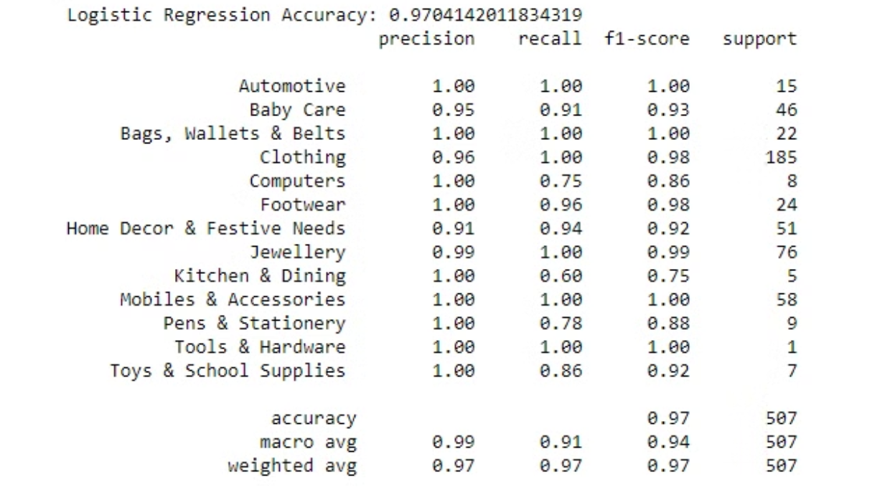

Slide 14
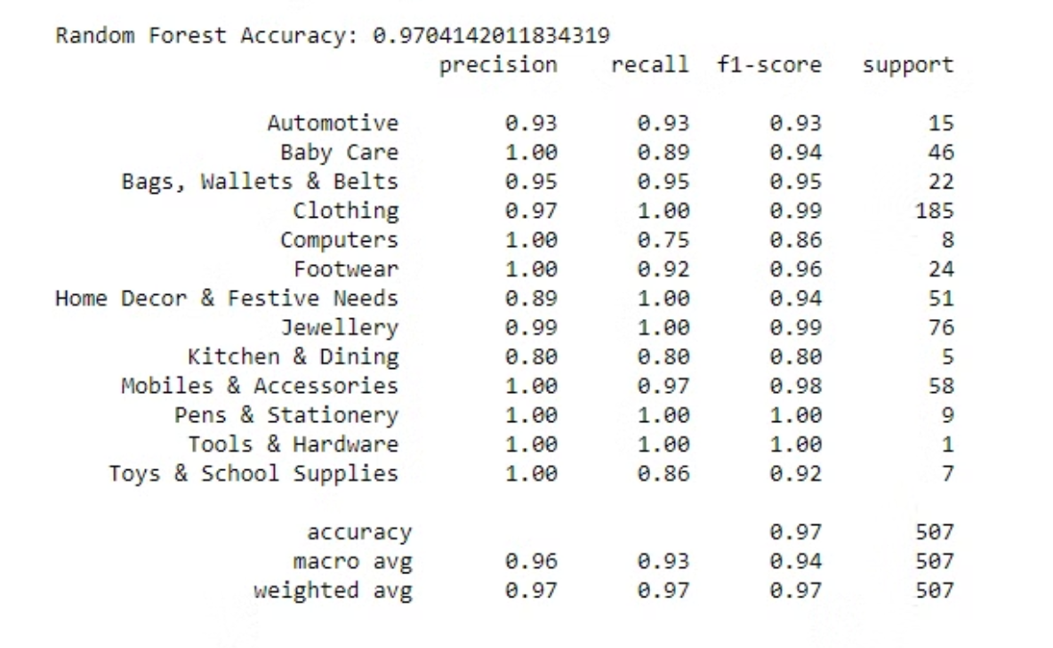

Slide 15
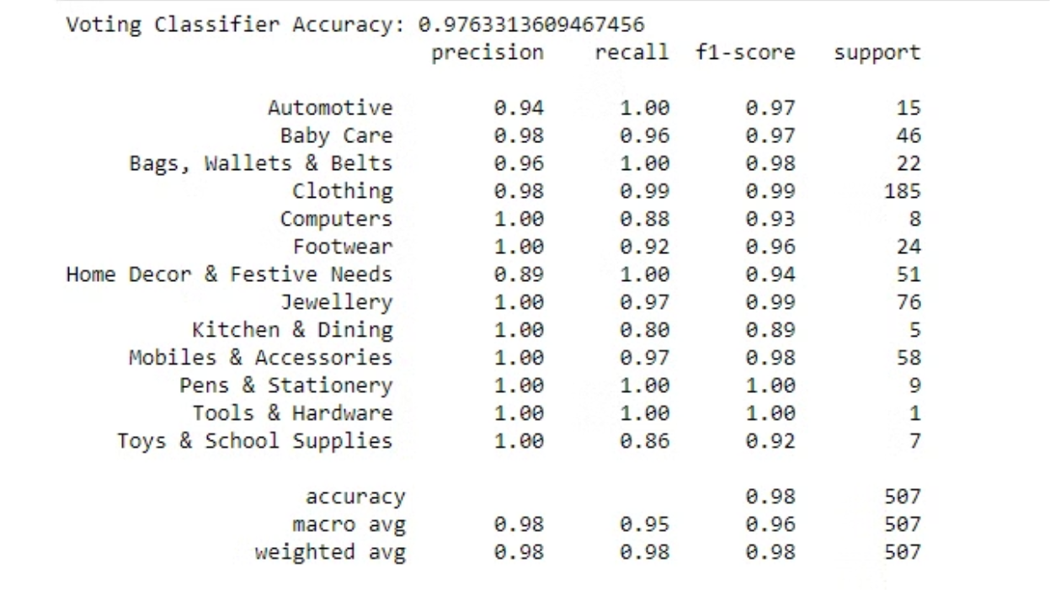

Slide 16
Conclusion and Business Impact
1
Key Findings
2
Business Impact
3
Next Steps
The enhanced product categorization model achieved high accuracy, precision, and recall, significantly improving the customer shopping experience and driving business growth.
Accurate product categorization leads to better search, recommendations, and cross-selling, resulting in increased customer satisfaction, loyalty, and revenue.
Continuously monitor and refine the model, incorporate new data sources, and explore further enhancements to maintain a competitive edge in the ecommerce landscape.

